Slide 1
The human heart
Anatomy

Slide 2
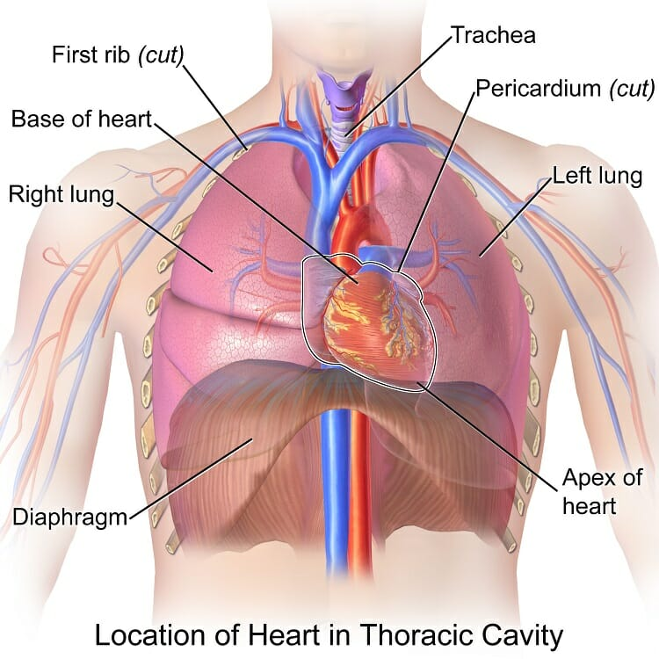

The heart
The heart lies in the chest cavity slightly towards the left-hand side.
It is approximately the size of your fist and is encased by protective tissue called the pericardium.

Slide 3
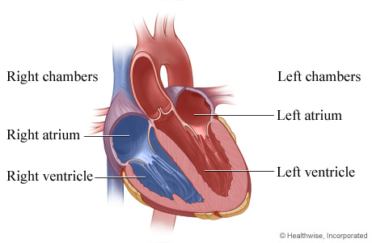
The heart structure
The heart contains 4 chambers:

Slide 4
Heart structure
The atria are smaller than the ventricles and have thinner, less muscular walls than the ventricles.
The atria act as receiving chambers for blood, so they are connected to the veins that carry blood to the heart.
The ventricles are the larger, stronger pumping chambers that send blood out of the heart.
The ventricles are connected to the arteries that carry blood away from the heart.

Slide 5
Heart chambers
The chambers on the right side of the heart are smaller and have less muscle in their heart wall when compared to the left side of the heart.
The right side of the heart maintains pulmonary circulation to the nearby lungs
while the left side of the heart pumps blood all the way to the extremities of the body in the systemic circulatory loop.

Slide 6
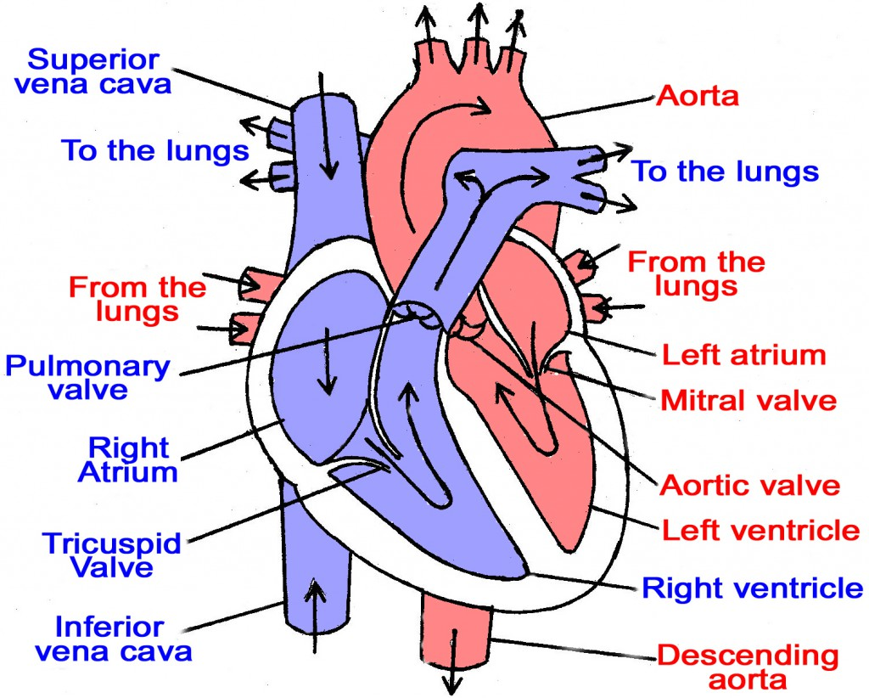
The human heart

Slide 7
Valves of the heart
The heart functions by pumping blood both to the lungs and to the systems of the body.
To prevent blood from flowing backwards or “regurgitating” back into the heart, a system of one-way valves are present in the heart.
The heart valves can be broken down into two types: atrio-ventricular and semilunar valves.

Slide 8
Valves of the heart
Atrio-ventricular valves. The atrio-ventricular (AV) valves are located in the middle of the heart between the atria and ventricles and only allow blood to flow from the atria into the ventricles.
Semi-lunar valves. The semi-lunar valves, so named for the crescent moon shape of their cusps, are located between the ventricles and the arteries that carry blood away from the heart.

Slide 9
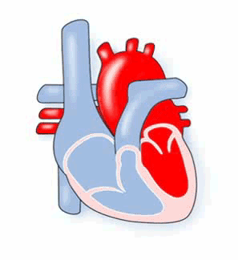
Blood flow through the heart

Slide 10
Blood flow
Deoxygenated blood returning from the body first enters the heart from the superior and inferior vena cava.
The blood enters the right atrium and is pumped through the atrio-ventricular valve into the right ventricle.
From the right ventricle, the blood is pumped through the pulmonary semilunar valve into the pulmonary artery.

Slide 11
Blood flow
The pulmonary artery carries blood to the lungs where it releases carbon dioxide and absorbs oxygen.
The blood in the lungs returns to the heart through the pulmonary veins.
From the pulmonary veins, blood enters the heart again in the left atrium.

Slide 12
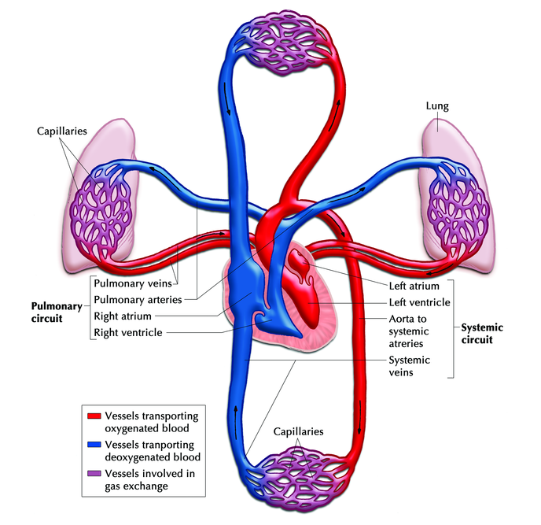
Pulmonary and systemic circulation

Slide 13
Blood flow
The left atrium contracts to pump blood through the bicuspid (mitral) valve into the left ventricle.
The left ventricle pumps blood through the aortic semilunar valve into the aorta.
From the aorta, blood enters into systemic circulation throughout the body tissues until it returns to the heart via the vena cava and the cycle repeats.

Slide 14
